Slide 1
Group 6:-Minimal Viable Product
By
Tyler Maregenetti, Jack E. Massey, Eva-Elena Bulai, Marta Velartova

Slide 2
Brief
What Genre are we using?
What Mechanic are we changing?
What are we changing the mechanic into?
What emotions are we looking for?
What are the Key Programming issues we will have?
What are the Key Design problems we will face?

Slide 3
Our Game: Genre and Emotions
Platformer
Sympathy:- For the character
Shock:- For the harsh failure states (when the Main Character dies)
Relief/fiero?:- For completing a difficult level

Slide 4
Our Gaming: Programming-wise
The player can control parts of the level, but not the main character
This involves the player moving parts of the level to allow the main character to move forward, which costs “mana”

Slide 5
Gameplay
[Insert video here]

Slide 6
Meeting MVP: Programing

Slide 7
Our Game: Level Design-wise
By Eva-Elena Bulai

Slide 8
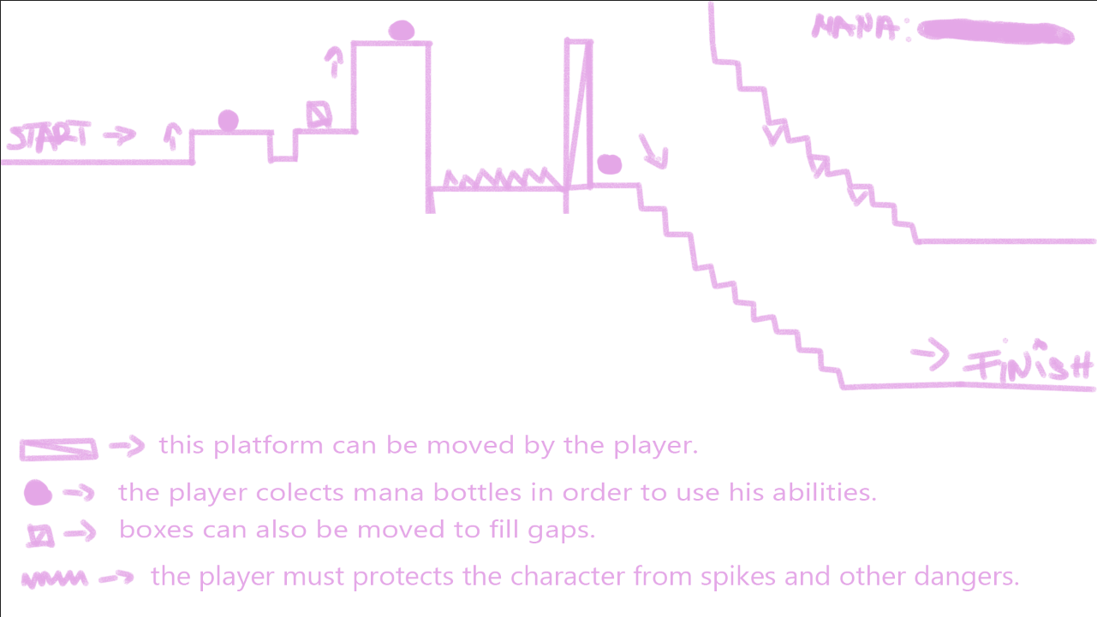
Level Design
The level design will be focused on gradual progression.
As the game progresses the challenge increases.

Slide 9
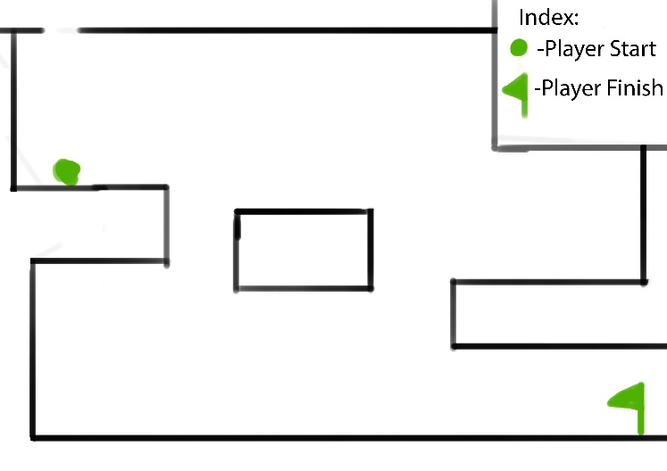
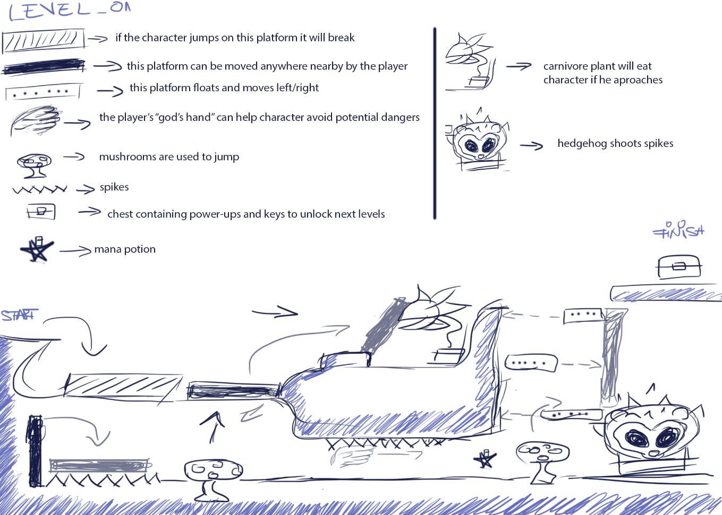

Other Level Design concepts
Level Concept by Eva
Level Concepts by Jack

Slide 10
Meeting MVP: Level Design
3 levels:
The Tutorial Level (learning the mechanics of the game)
A beginners styled level (to test the players learning)
A intermediate level (to challenge the player)

Slide 11
Our Game: Art
By Marta Velartova

Slide 12
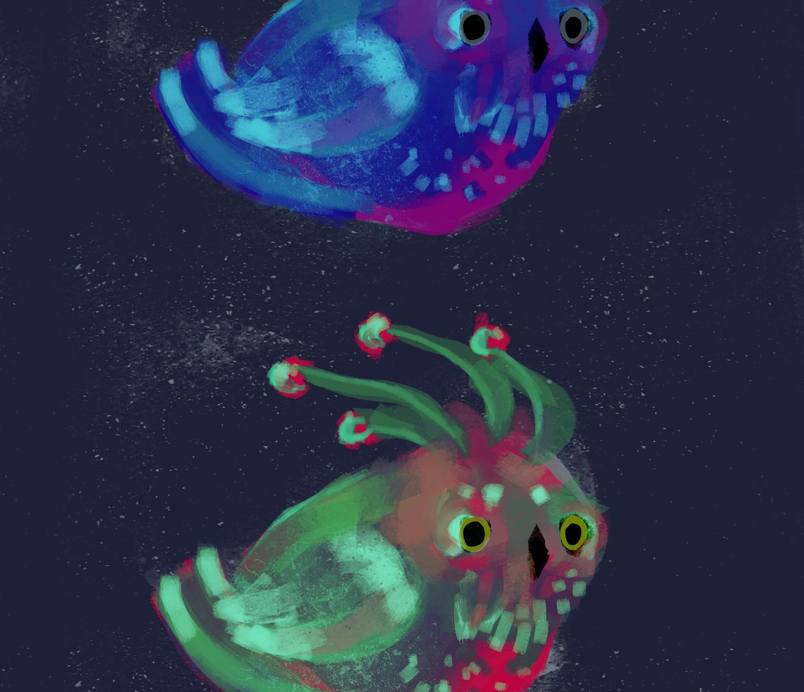
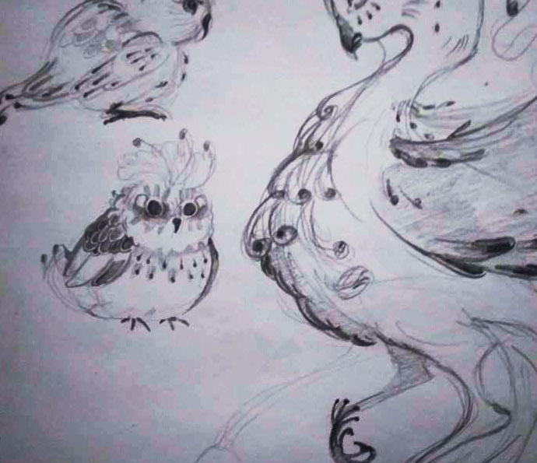
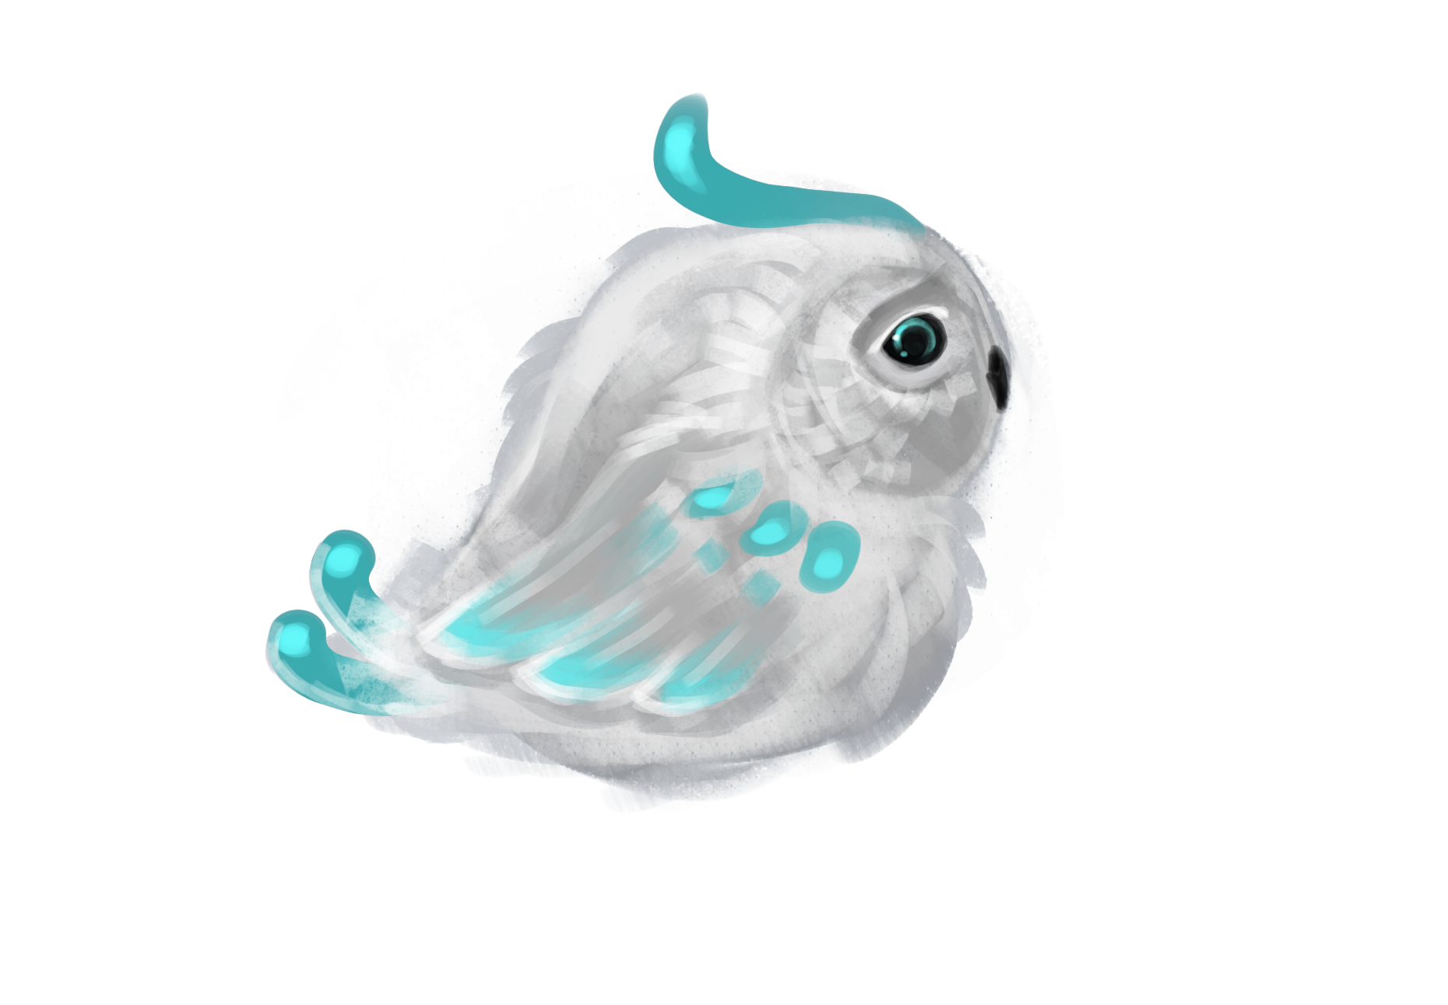
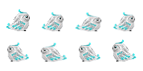
Art: Main Character
Little bird from magical world fell off his nest and is trying to get home
Must be cute, and magical looking
We want player to want to protect this character - small adorable animal, sad look
We want to create sympathy for the character

Slide 13







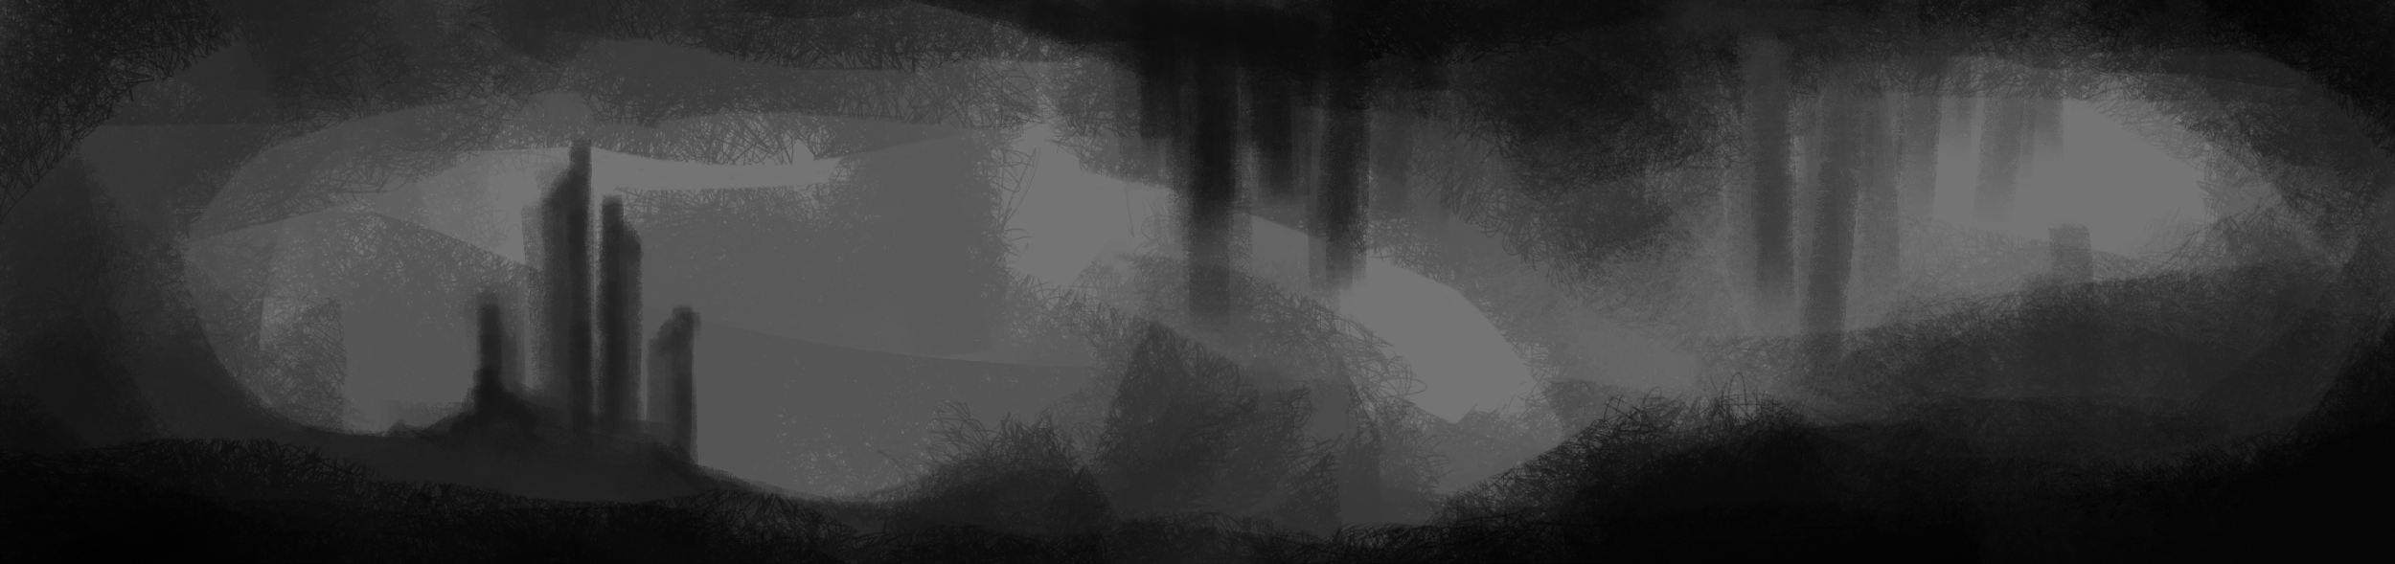




Art: assets
Character travels through different locations trying to find his way home – various locations - various assets
Starting from more dull levels (easy and not as colorful levels) and step by step is getting to the place where he belongs (colorful and more challenging levels)

Slide 14
Meeting MVP: Art
Finalised designs of:
The God hand (The mouse)
Mana potions
Dangers (Spikes, etc)

Slide 15


